Slide 1
Notes:
The Number Day assembly plan and presentation can help teachers to explain why their school is taking part in Number Day and how everyone can make a difference by having fun with numbers and using maths activities to help raise money.
To be presented in the two week leading up to Number Day
By the end of the assembly pupils will:
Understand the purpose of Number Day to: a) raise money for the NSPCC b) have fun with numbers and promote a positive “can do” attitude to maths.
Understand about the work of the NSPCC as a charitable organisation and how we help children and young people
Feel motivated and proud to make a difference
Don’t forget to display the NSPCC Number Day posters around the school.

Slide 2
Notes:
Hands up - who enjoys playing board games or cards? Or watching, “Countdown”, “Pointless”, “Catchphrase”, “Tipping Point” or “The Cube”.
Ask the children to tell you the maths or number based games they enjoy playing or watching.
Ask the children to explain why they enjoy these games and programmes.
They may offer answers such as “They are fun/interesting”. “I like watching them with my friends and family” or you can learn from them.
Take a variety of responses and use their answers to draw out what they can learn from playing such number games.
The children may offer answers like: “You can learn about counting, adding, subtracting, taking turns, strategy etc..”
Try to establish the link between the ideas of number games and the enjoyment and learning about maths. Once you feel you have established a context for introducing the subject of the assembly, tell them that on Friday 2 February everyone in school will have the chance to enjoy some number games and maths activities to celebrate Number Day and that “All over the Country’ other schools will be doing the same: celebrating how much fun maths can be”.

Slide 3
Notes:
Once the children are interested and motivated to take part in Number Day, explain to them that there is another reason why taking part is so important to them – they will “have the opportunity to raise money for thousands of children all over the country who are being helped by a charity called the NSPCC”.

Slide 4
Notes:
The NSPCC is a charity who want every child to a safe and happy childhood.

Slide 5
Notes:
Explain that your school will be joining hundreds of other schools across the UK to take part in Number Day and to raise money for the NSPCC
Ask if anyone has heard of the NSPCC ? Does anyone know what the initials NSPCC stand for?

Slide 6
Notes:
Explain that your school will be joining hundreds of other schools across the UK to take part in Number Day and to raise money for the NSPCC
Ask if anyone has heard of the NSPCC ? Does anyone know what the initials NSPCC stand for?
To understand a little more about the work of the NSPCC, lets look at the initials to understand exactly how they help children and young people
Run through each letter and ask pupils what the meaning of each letter is.
For example National = The NSPCC works all over the country,
Society = is like a group of people who have come together, some pupils may be members of their local scouts or brownies. A society is another word for a group of people,
Prevention = another word for prevention is ‘stop’,
Cruelty = another word for cruelty could be mean, nasty, horrible (to expand on this section you could run through the different types of harm in the appendix)
Children = ask the pupils what age do you stop being a child? The answer is 18

Slide 7
Notes:
Explain that your school will be joining hundreds of other schools across the UK to take part in Number Day and to raise money for the NSPCC
Ask if anyone has heard of the NSPCC ? Does anyone know what the initials NSPCC stand for?
To understand a little more about the work of the NSPCC, lets look at the initials to understand exactly how they help children and young people
Run through each letter and ask pupils what the meaning of each letter is.
For example National = The NSPCC works all over the country,
Society = is like a group of people who have come together, some pupils may be members of their local scouts or brownies. A society is another word for a group of people,
Prevention = another word for prevention is ‘stop’,
Cruelty = another word for cruelty could be mean, nasty, horrible (to expand on this section you could run through the different types of harm in the appendix)
Children = ask the pupils what age do you stop being a child? The answer is 18

Slide 9
Notes:
Explain that your school will be joining hundreds of other schools across the UK to take part in Number Day and to raise money for the NSPCC
Ask if anyone has heard of the NSPCC ? Does anyone know what the initials NSPCC stand for?
To understand a little more about the work of the NSPCC, lets look at the initials to understand exactly how they help children and young people
Run through each letter and ask pupils what the meaning of each letter is.
For example National = The NSPCC works all over the country,
Society = is like a group of people who have come together, some pupils may be members of their local scouts or brownies. A society is another word for a group of people,
Prevention = another word for prevention is ‘stop’,
Cruelty = another word for cruelty could be mean, nasty, horrible (to expand on this section you could run through the different types of harm in the appendix)
Children = ask the pupils what age do you stop being a child? The answer is 18

Slide 10
Notes:
Explain that your school will be joining hundreds of other schools across the UK to take part in Number Day and to raise money for the NSPCC
Ask if anyone has heard of the NSPCC ? Does anyone know what the initials NSPCC stand for?
To understand a little more about the work of the NSPCC, lets look at the initials to understand exactly how they help children and young people
Run through each letter and ask pupils what the meaning of each letter is.
For example National = The NSPCC works all over the country,
Society = is like a group of people who have come together, some pupils may be members of their local scouts or brownies. A society is another word for a group of people,
Prevention = another word for prevention is ‘stop’,
Cruelty = another word for cruelty could be mean, nasty, horrible (to expand on this section you could run through the different types of harm in the appendix)
Children = ask the pupils what age do you stop being a child? The answer is 18

Slide 11
Notes:
Keeping children safe is why the NSPCC is here. That’s what drives their work, and that’s why – as long as children need support – they will fight for every childhood.
So when a child needs a helping hand, they’ll be there.
When parents are finding it tough, they’ll help.
When laws need to change, or governments need to do more, they won’t give up.

Slide 12
Notes:
It is really important to speak out to a trusted adult or grown up if you are ever worried, upset or need to talk. Childline, a service provided by NSPCC is also there to listen to children and young people, whatever their worry, whenever they need help.
A child contacts Childline every 20 seconds – they can talk about anything, and often it’s a problem they feel they can’t talk to anyone else about. A child or young person can contact Childline, they can do this by calling 0800 1111 or visiting childline.org.uk
Childline is open 24 hours a day, 365 days a year, it’s never closed.
The fundraising they are doing in school is helping to fund the NSPCC’s services that include the Speak out Stay safe programme.

Slide 13
Notes:
The NSPCC Schools Service visits schools in every town and city in the UK to teach children about the different types of harm and how to keep safe. Children also learn the importance of speaking out to a grown-up or trusted adult if they need help.
They do this through a series of assemblies and workshops called the ‘Speak out. Stay safe.’ programme.
If you are a Primary School – hopefully you’ve had the service in your school and can remind the children about when Buddy and the Speak out Stay safe programme visited your school. If you’ve not had the service and would like us to come along to your Primary School, please go to www.nspcc.org.uk/schools to request a visit.
If you are a Secondary School, you could ask the children if they remember Buddy coming to their Primary School.
The fundraising they are doing in your school is helping to fund the NSPCC’s services that include the Speak out Stay safe programme.

Slide 14
Notes:
The NSPCC has many other services across the UK that you will be helping to raise money for. Make the link between maths / numbers and helping children raise money for other children
It takes a lot of time and a lot of money to ensure that ChildLine and NSPCC’s others services are there every day for children and young people. Our school is joining hundreds of others to take part in NSPCC Number Day and help raise money for children
There are some Number Day sponsor forms to distribute and posters to promote Number Day during the run up to Number Day on 1 February 2019

Slide 15
^{Our Number Day Event}
^{Friday 1st February}
^{Blank for your to share} ^{plans with your pupils}
Notes:
Please insert the details of your schools Number Day event:-
What activity you are doing
The amount of time your school is dedicating to Number Day (a lesson or a whole digit day!)
Who will be taking part – teachers and parents can join in too
Why not ask the School or Pupil Council to help organise the event and make a display
It is suggested that you send a covering letter to parents (template available to download) to explain about the purpose of NSPCC Number Day and to generate their support.
You can also use the posters and press releases from the Number Day website to promote your event.

Slide 16
Notes:
Explain what your number crunching, digit day event is and how the children will be raising money by either collecting sponsors or asking for donations
In your fundraising pack there is a sample sponsor form which can be photocopied. The sponsor form can also be downloaded from the Number Day website.

Slide 17
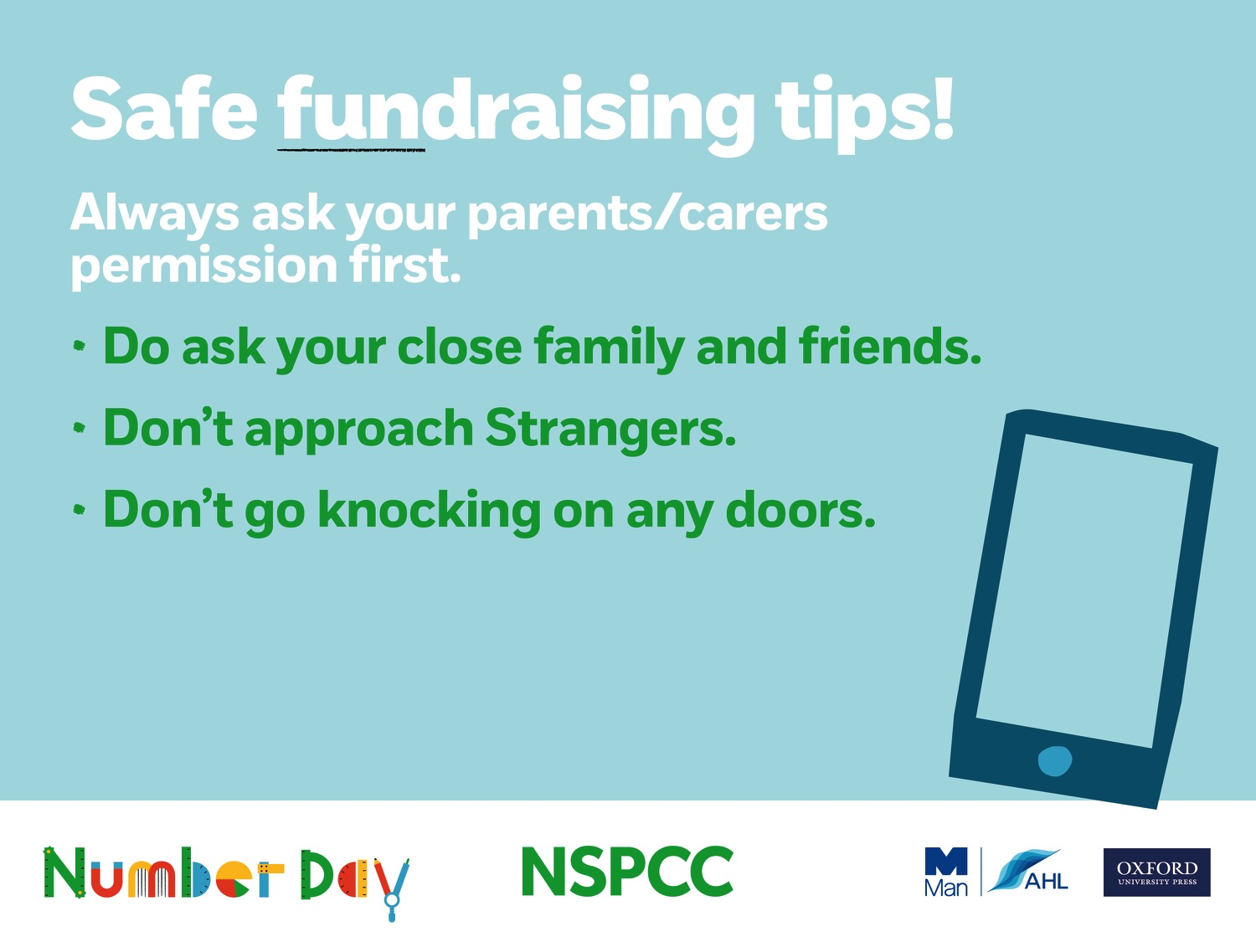
Notes:
If the children are collecting sponsors, there are some important safety messages for the children
Always ask your parents/carers permission to take part in NSPCC Number Day and raise money. If they say yes – fantastic! Please collect some sponsors or people who will give you a donation for completing your special Number Day challenge.
“There are lots of people you can ask to sponsor you/give a donation - mum, dad or whoever looks after you, nan, granddad, aunts, uncles, family friends and their work colleagues.
You might be able to help in a small way. You might, with the help of your family and friends be able to help in a big way. Whichever it is, remember this is not a competition. It is much more important than that. The money we raise at (name of your school) on Number Day will help lots of children to have a happy and safe childhood and that’s something we can feel really proud about.

Slide 18
Title here!
These next few slides are blank. Amend to promote your school’s Number Day.

Slide 19
^{Blank for your to share} ^{plans with your pupils}

Slide 20
Title here!
These next few slides are blank. Amend to promote your school’s Number Day.

Slide 21
Notes:
Summarise your school plans and remind the children of the date.

