Slide 1
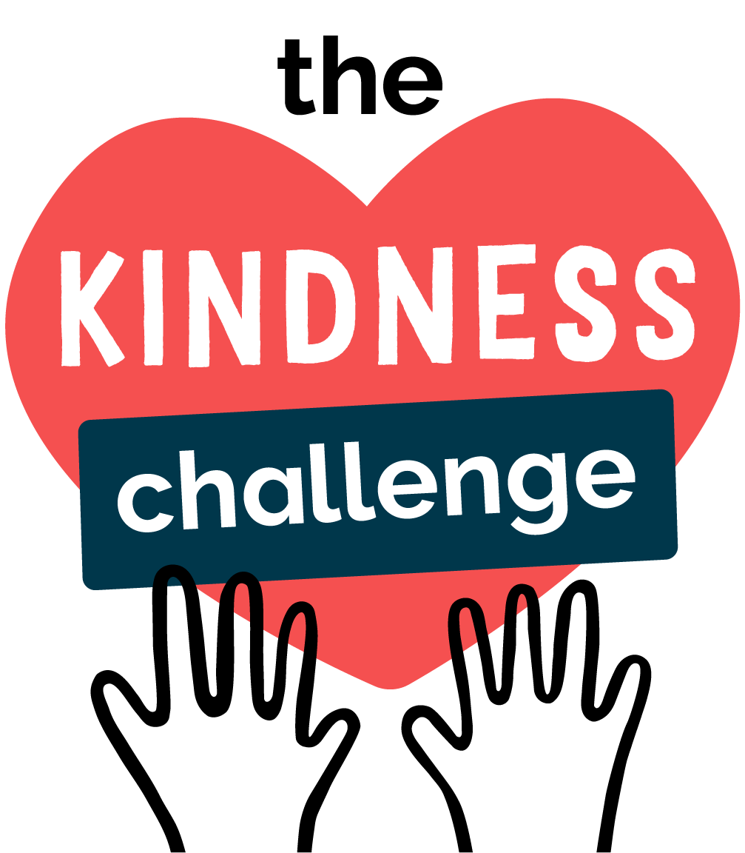

THE KINDNESS CHALLENGE

Slide 2



What is Kindness?
Kindness means noticing when someone needs a hand, a smile, or a friend and choosing to help, even in a small way.
A friendly smile
Saying good morning, smiling at someone new, or asking “are you OK?”
Including others
Inviting someone to join your game, or sitting with someone who's on their own.
A helping hand
Helping with homework, tidying up together, or sharing something you have.

Slide 3
How might you be kind to your teacher?

Slide 4
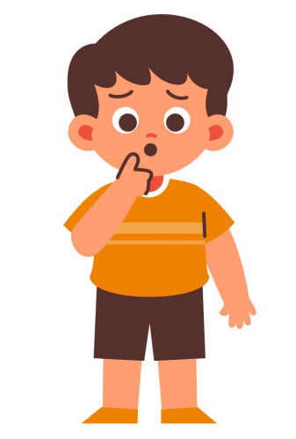
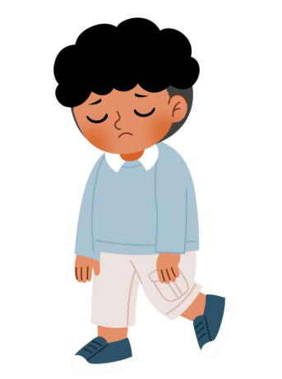
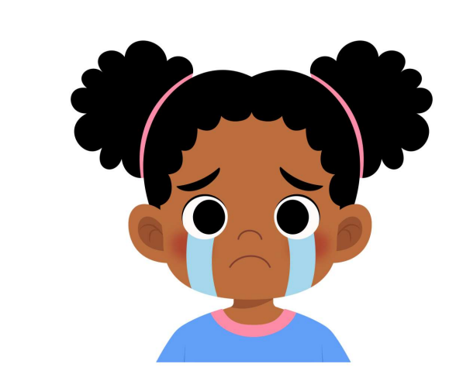
How could you show kindness?
Today is Ben's first day at school. He doesn't know anyone yet and isn't sure where to go.
Sam is standing by himself at playtime. The other children are playing together, but no one has asked him to join in.
During class, Amira gets an answer wrong. Some children laugh, and Amira feels upset.
Small acts of kindness in our school can add up to something that helps children everywhere.

Slide 5
Why is being kind important?

Slide 6
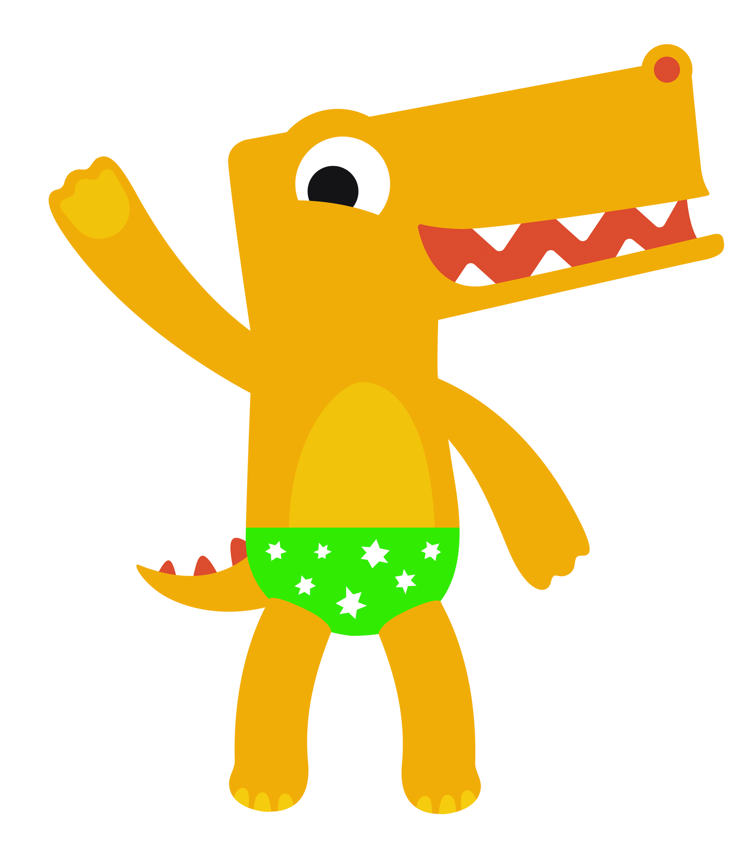


How the NSPCC show kindness
A charity is a group of people who work together to help others
People give charities their time, money, or kindness. Charities use it to help people, children, animals, or the planet.
Childline is the NSPCC's service for children and young people.
Someone who listens
Always there
Trained counsellors listen without judging — about bullying, worries, home life, or anything at all.
Childline has supported children for 40 years, so no one ever has to face a problem alone.

Slide 7

Your Kindness Challenge
This week, try to complete one kind act every day. Here are some ideas to get started:
Smile and say good morning to someone new
Help a classmate who is stuck
Include someone in your game
Say something kind to a family member
Tidy up without being asked
Listen if a friend needs to talk

