Slide 1

Notes:
Title page – text only

Slide 2
What is a charity?
An organisation set up to provide help and raise money for those in need.
The NSPCC is a charity who want to help every child to have a safe and happy childhood.
Notes:
Title page – text only

Slide 3



Notes:
Explain that your school will be joining hundreds of other schools across the UK to take part in Number Day and to raise money for the NSPCC
Ask if anyone has heard of the NSPCC ? Does anyone know what the initials NSPCC stand for?

Slide 4

Notes:
For example National = The NSPCC works all over the country,

Slide 5

Notes:
Society = is like a group of people who have come together, some pupils may be members of their local scouts or brownies. A society is another word for a group of people,

Slide 6

Notes:
Prevention = another word for prevention is ‘stop’,

Slide 7

Notes:
Cruelty = another word for cruelty could be mean, nasty, horrible (to expand on this section you could run through the different types of harm in the appendix)

Slide 8

Notes:
Children = ask the pupils what age do you stop being a child? The answer is 18

Slide 9
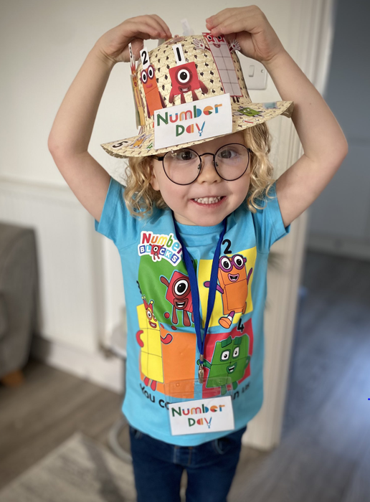
Keeping children safe is why the NSPCC is here:
When a child needs a helping hand, they’ll be there.
When parents are finding it tough, they’ll help.
When laws need to change, or governments need to do more, they won’t give up.
Notes:
Keeping children safe is why the NSPCC is here. That’s what drives their work, and that’s why – as long as children need support – they will fight for every childhood.
So when a child needs a helping hand, they’ll be there.
When parents are finding it tough, they’ll help.
When laws need to change, or governments need to do more, they won’t give up.

Slide 10


Childline gives children
and young people a voice
Online, on the phone, anytime
0800 1111
childline.org.uk
Notes:
Childline
It is really important to speak out to a safe adult or grown up if you are ever worried, upset or need to talk.
Childline, a service provided by NSPCC is also there to listen to children and young people, whatever their worry, whenever they need help.
On average, a child contacts Childline every 45 seconds – they can talk about anything, and often it’s a problem they feel they can’t talk to anyone else about. A child or young person can contact Childline, they can do this by calling 0800 1111 or visiting childline.org.uk
Childline is open 24 hours a day, 365 days a year, it’s never closed.
The fundraising we are doing in school is helping to pay for the NSPCC’s services that include the Speak out Stay safe programme and Childline.
Use this slide as required.

Slide 11


Speak out
Stay safe
Notes:
Speak out Stay safe is our safeguarding programme for 5-11-year-olds.
It’s available to all primary schools in the UK and Channel Islands.
It teaches children what abuse is, that abuse is never a child’s fault and that they have the right to be safe. It also teaches them that they can speak to a safe adult or Childline if they
ever need help or support.
nspcc.org.uk/SOSS
The Speak out Stay safe programme contains:
virtual assemblies for children aged 5-7 and 7-11, available in English, Welsh and BSL
follow on lesson plans with engaging activities and resources to help reinforce and embed key messages (available in both English and Welsh)
face-to-face workshops for children aged 6-7 and 9-11 (talk to us about availability in your area).
You'll be supported by a local Schools Co-ordinator who can answer any questions you have about the programme and help you access other support, resources and training.
There is also an adapted six week Speak out Stay safe programme for children with special educational needs and disabilities (SEND) and additional needs (ASN/ALN).
[Primary Schools – hopefully you’ve had the service in your school and can remind the children about when Buddy and the Speak out Stay safe programme visited your school. If you’ve not had the service and would like to find out more , please go to www.nspcc.org.uk/speakout to sign up.)
[Post Primary Schools, you could ask the children if they remember Buddy coming to their Primary School]
Use this slide as required depending on your content.

Slide 12

^{Our Number Day Event}
^{Friday 2 February 2024}
^{Blank for your to share}
^{plans with your pupils}
Notes:
The NSPCC has many other services across the UK that you will be helping to raise money for. Make the link between maths / numbers and helping children raise money for other children
It takes a lot of time and a lot of money to ensure that Childline and NSPCC’s other services are there every day for children and young people. Our school is joining hundreds of others to take part in NSPCC Number Day and help raise money for children.
Please insert the details of your schools Number Day event:-
What activity you are doing (Teacher: Have a look at our fun new Buddy’s Key Challenge sponsored event – find out more at www.nspcc.org.uk/numberdayresources)
The amount of time your class is dedicating to Number Day (a lesson or a whole digit day!)
Who will be taking part – teachers and parents can join in too
Why not ask the School or Pupil Council to help organise the event and make a display
You could send a covering letter to parents (template available to download) to explain about the purpose of NSPCC Number Day and to generate their support.
You can also use the posters and press releases from the Number Day website to promote your event.
Raise money and donate using the details in your welcome letter or using ParentPay or JustGiving

Slide 13


Notes:
Explain what your number crunching, digit day event is and how the children will be raising money by either collecting sponsors or asking for donations
In your fundraising pack there is a sample sponsor form which can be photocopied. The sponsor form can also be downloaded from the Number Day website.
£4 could pay for one of our trained volunteer counsellors to answer a child's call for help to Childline.
£400 could pay for one of our trained volunteer counsellors to answer 100 calls to Childline.
£4 could pay for one of our trained volunteer counsellors to answer 300 calls to Childline.

Slide 14
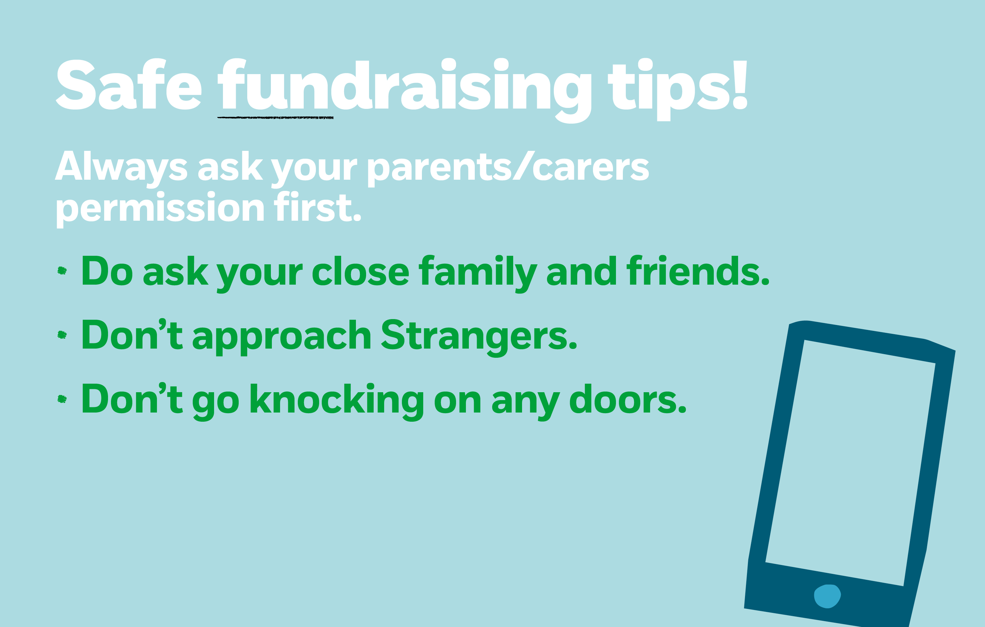
Notes:
TEACHERS NOTES:
Please follow local, national and school Covid Staying Safe Guidance when Fundraising.
ParentPay and JustGiving are two options for collecting and donating money safely.
Always ask parents/carers permission to take part in NSPCC Number Day and raise money. If they say yes – fantastic! Please collect some sponsors or ask people your know to give a donation to NSPCC for completing your special Number Day challenge.
“There are lots of people you can ask to sponsor you/give a donation - mum, dad or whoever looks after you, nan, granddad, aunts, uncles, family friends and their work colleagues. Share your schools JustGiving page to all parents and ask them ro promote to friends and family. Please also follow your local Covid regulations).
You might be able to help in a small way. You might, with the help of your family and friends be able to help in a big way. Whichever it is, remember this is not a competition. It is much more important than that. The money we raise at (name of school) on Number Day will help lots of children to have a happy and safe childhood and that’s something we can feel really proud about.

Slide 15

Title here!
The next slide can be used to promote Buddy’s Key Challenge if you are doing this at your school.
These next few slides are designed for you to amend to promote your school’s Number Day.

Slide 16

^{Buddy’s Key Challenge}
Buddy really wants to visit
our school!
Can you solve maths puzzles against the clock? Can you find hidden pieces of a key to unlock a magic door to welcome Buddy to our school?
Notes:
Teacher: Use this slide if you are taking part in Buddy’s Key Challenge, our Sponsored Event activity. You can adapt and share this page with pupils. See Buddy’s Key Challenge class resources at nspcc.org.uk/numberdayresources.
Who remembers Buddy? Buddy is a friendly green speech bubble and an NSPCC mascot. He represents what the NSPCC believes in. That children should speak out to a safe adult or grown-up to get the help they need and to stay safe from harm.
Buddy would really like to visit our school. In our class, we are going to take part in Buddy’s Key Challenge. You have an hour to solves puzzles together to find hidden pieces of a key to unlock a magic door and welcome Buddy to our school.
Please ask parents, carers and family members to sponsor you, if they can, so we can raise money for the NSPCC and Childline as well. (Teacher: Information on setting up a school Number Day JustGiving Page on our Number Day resources page)
If you would like to take part in Buddy’s Key Challenge can you count to three. Put your thumbs up in the air like Buddy. Ready? 1, 2, 3! Fabulous.

Slide 17




Check out the amazing resources from our partners and supporters
www.nspcc.org.uk/support-us/charity-fundraising/schools-fundraising-ideas/number-day/resources
Notes:
Please review all the amazing resources and activities from our partners and supporters
There are videos and messages to check out too
Each year we add new ideas and this year we have refreshed the resources page to help you find the perfect downloadable worksheets for your nursery or school

Slide 18

Title here!
These next few slides are blank. Amend to promote your school’s Number Day.

Slide 19
Raise money
and have fun!
Notes:
We will receive a certificate showing how much sponsorship the whole school has raised doing Buddy’s Key Challenge, and what the money will be spent on.

Slide 20

Notes:
Key Messages:
Hands up - who enjoys playing board games or cards? Or watching, “Countdown”, “Pointless”, “Catchphrase”, “Tipping Point” or “The Cube”.
Ask the children if they enjoy watching and playing Number based games and quizzes and to explain why they enjoy these games and programmes. They may offer answers such as “They are fun/interesting”. “I like watching them with my friends and family” or you can learn from them.
Take a variety of responses and use their answers to draw out what they can learn from playing such number games.
The children may offer answers like: “You can learn about counting, adding, subtracting, taking turns, strategy etc..”
Try to establish the link between the ideas of number games and the enjoyment and learning about maths. Once you feel you have established a context for introducing the subject of the assembly, tell them that on Friday 2 February (or on another day that suits) everyone in school will have the chance to enjoy some number games and maths activities to celebrate Number Day and that “All over the Country’ other schools will be doing the same: celebrating how much fun maths can be”.
Once the children are interested and motivated to take part in Number Day, explain to them that there is another reason why taking part is so important to them – they will “have the opportunity to raise money for thousands of children all over the country who are being helped by a charity called the NSPCC”.

Slide 21

©NSPCC 2023. National Society for the Prevention of Cruelty to Children. Registered charity England and Wales 216401,
Scotland SC037717 and Jersey 384. Photography by Tom Hull, Harry George Hall, and Adrian James White. Children and adults
pictured are models and volunteers. Photography includes a real-life NSPCC Childline counsellor, Sarah Murphy. J2023009.
Notes:
End slide option 1

