Slide 1




Jobs with maths
A quiz
Supported by Oxford University Press.
Notes:
Notes for Teachers:
This session is mainly aimed at lower ability /key stages.
The aim is to discuss how professionals use maths in their work. The examples we have provided are illustrative examples only, we advise teachers should use their judgement with regard to the age of their class and appropriateness.
You have the option to use version 2 for more of a challenge. You have the option to print and display the word tiles at the end of this powerpoint.
In this version, the pupils are challenged with unjumbling the answers from the screen to get 1 point. Encourage discussion before the clue appears on the board on how they think maths might apply to the profession. This encourages thinking and includes all abilities.
Pupils can work on their own, in pairs or in groups to encourage participation.
The clues appear when you are ready for them but for more able groups you may prefer to show them instead of initial ideas.
Resources:
Paper to write down answers for questions 1-6, pencils.
Teacher notes to the powerpoint (on each slide deck, alternatively print a copy with the notes pages for each slide)
Optional: timer for each question
Paper, crayons/pencils for plenary or extension activities (last slide)

Slide 2
Numbers and mathematics are used in many different ways, including at work.
What is your
dream job?
Notes:
Starter activity – Class Discussion: opportunity for the class to share their dream jobs

Slide 3
Professionals use maths at work.
How might you use maths in your dream job?
Notes:
Starter activity- Class Discussion : opportunity for the class to expand on their answers using mathematical terms/types of numbers.

Slide 4
For the following seven professionals, you will see an example of how they use maths in work.
You need to unjumble the anagram example to score a point. There is one point per correct answer.
Notes:
Option for the class to give answers verbally or write down the answers.

Slide 5

Example:
Who does this profession use maths?
Baker
Unjumble this word to reveal the answer: thegwis
Notes:
ASK THE PUPILS TO UNJUMBLE THE ANSWERS. AIM TO ENCOURAGE DISCUSSION.

Slide 6
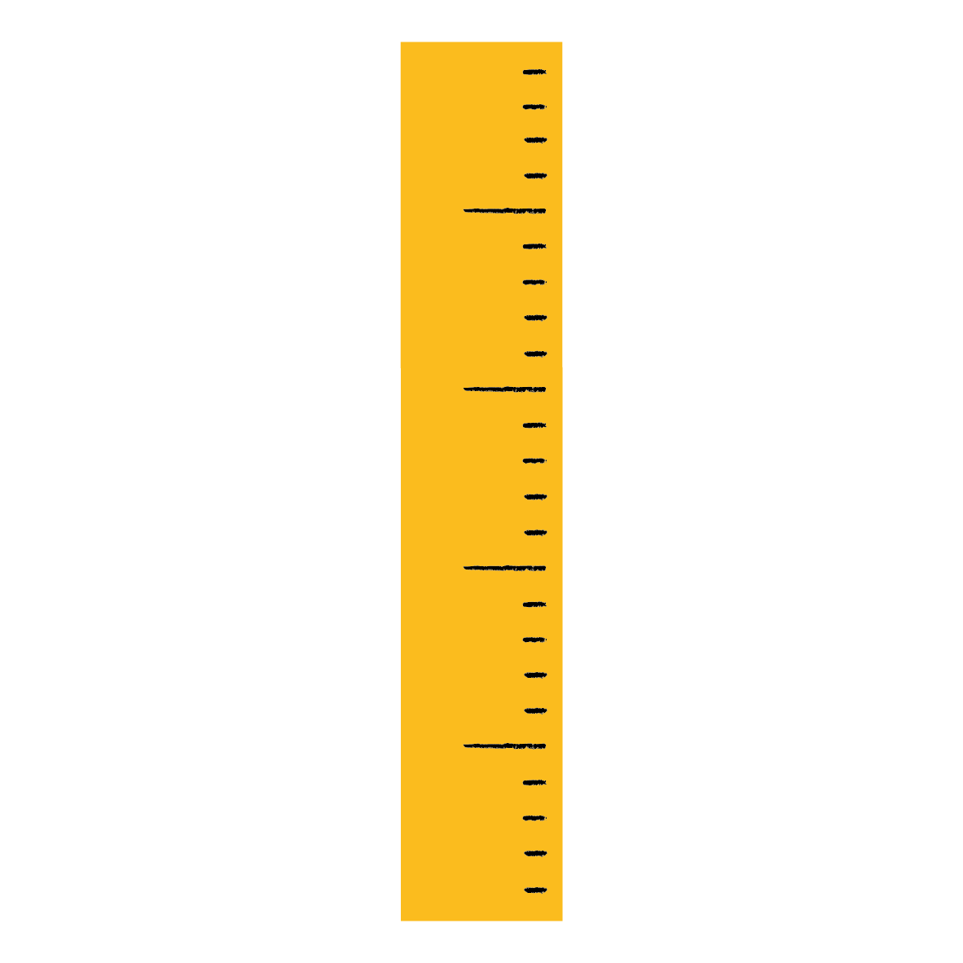
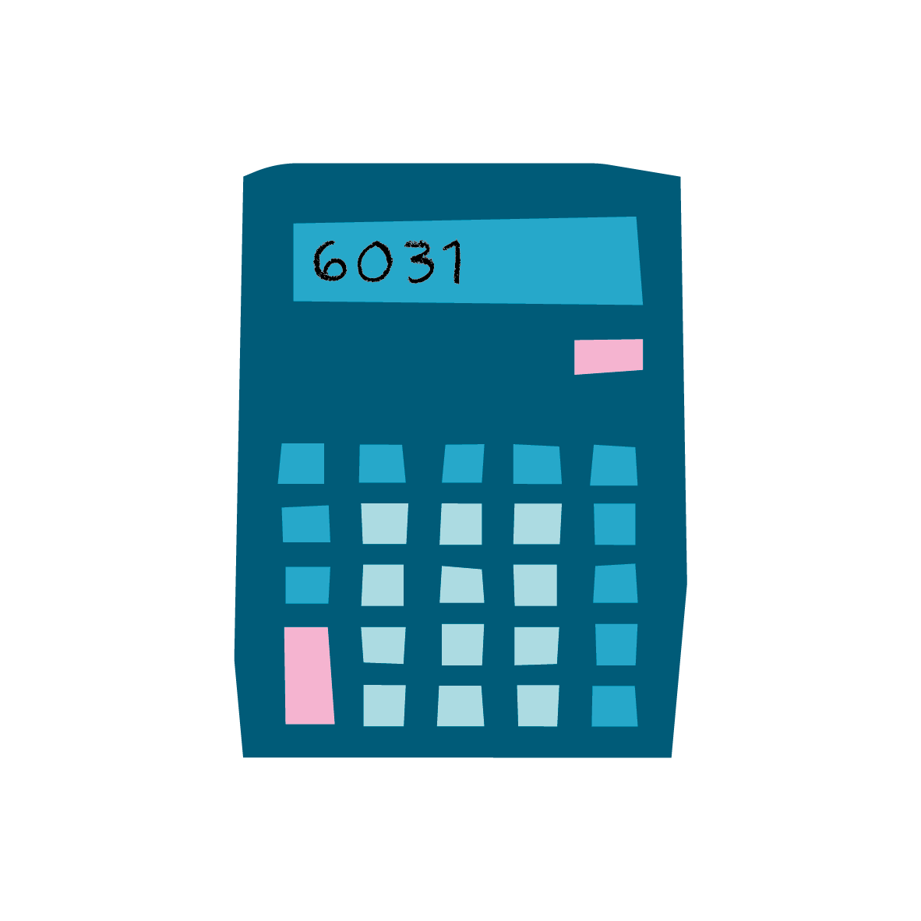

Prepare your answer sheet;
1. Example: Weights
2.
3.
4.
5.
6.
7.
Notes:
OPTION: Ask pupils to write down their answers.
Alternatively take verbal answers from the class for each question, or mark the answers as you go along.

Slide 7

2. Doctors
Unjumble the answer:
icttsistsa
Notes:
AIM TO ENCOURAGE DISCUSSION. USE A TIMER.
Doctors use statistics and probability to interpret tests results. When a patient is treated for an illness, the probability is used to determine which type of treatment to use. Evidence-based medicine is the use of statistical models to guide diagnoses and treatment.

Slide 8
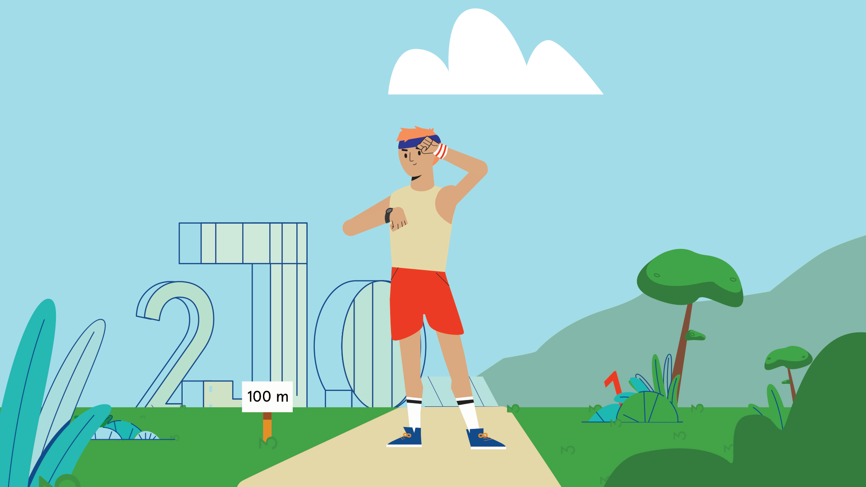
3. Sports professionals
Unjumble the answer:
soarti
Notes:
USE A TIMER.
Ratios are used extensively in sports to measure the success rate of a particular task or skill. A sports professional uses math to calculate, understand and interpret these ratios. For example, footballer’s strike -rate percentage, which is the ratio of successful shots to total shots taken.

Slide 9
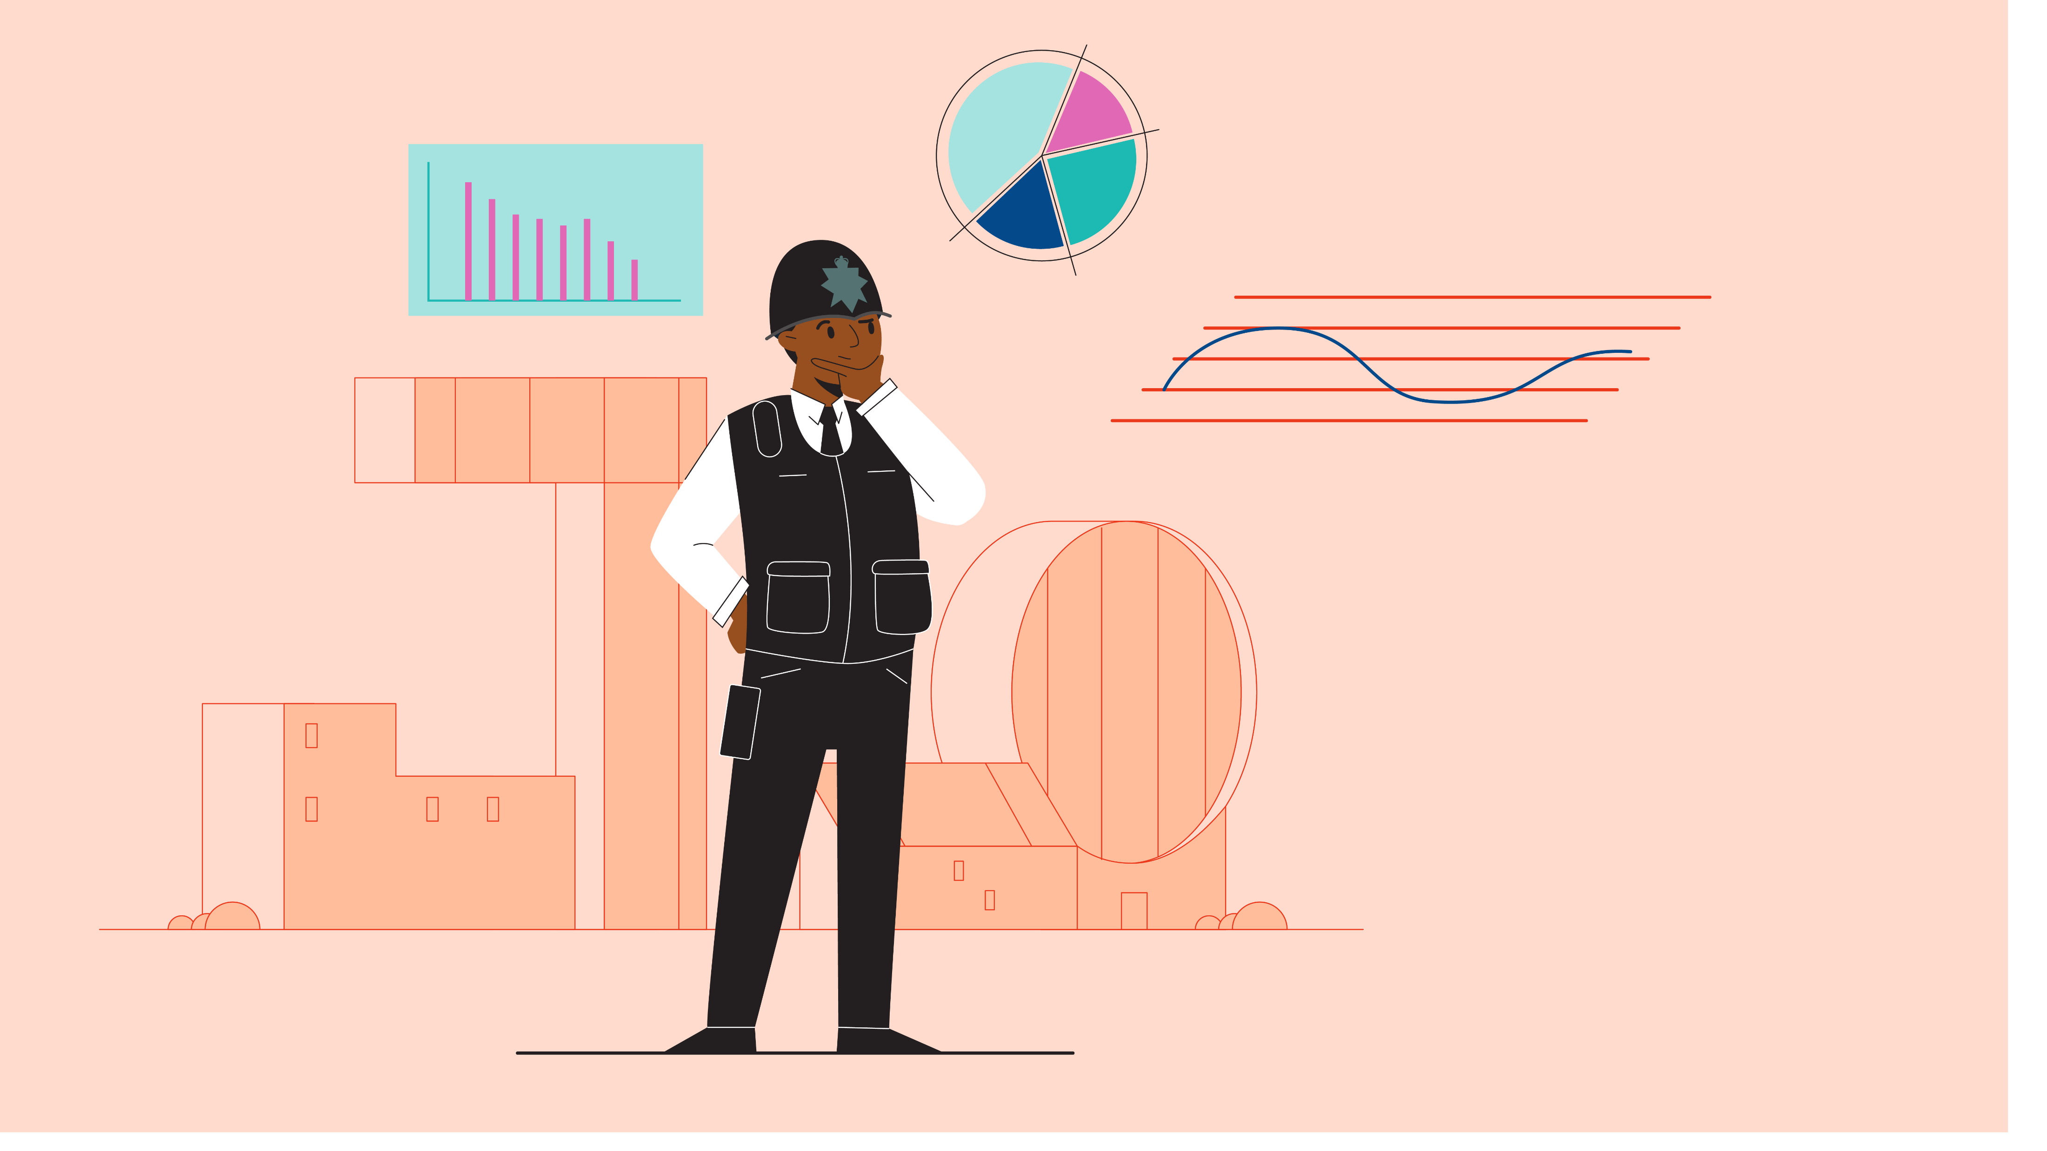
4. Police
Unjumble the answer:
rablega
Notes:
USE A TIMER.
Police officers use algebra skills in traffic accident investigations. Algebra helps investigating officers calculate the speed of the vehicles involved, the distance travelled and the vehicles’ locations at the time of the collision. For police officers, detectives and crime scene investigators, algebra is a helpful tool in crime scene reconstruction. In cases involving death, investigators use algebra to estimate the time of death using factors such as climate conditions and body temperature. Algebra also is useful for ballistics in firearms-related offenses.

Slide 10

5. Designers
Unjumble the answer:
ogmeyetr
Notes:
USE A TIMER.
Geometry is integral to all forms of design. Fashion designers make use of it in decisions regarding shapes, patterns and prints, whereas angles play a role in determining necklines and hems, for instance. Architects use geometry to help them design buildings and structures. It can help architects express design images and to analyse as well as calculate possible structural problems.

Slide 11

6. Artists
Unjumble the answer:
nmeaursmeets
Notes:
USE A TIMER.
Measurement is key for an artist to draw correct proportions and angles and a realistic interpretation of their subject. There are several measurement techniques that artists use including the use of grids, tick marks, rule of thumbs, rule of threes. A photographer uses measurement to determine light and exposure.

Slide 12
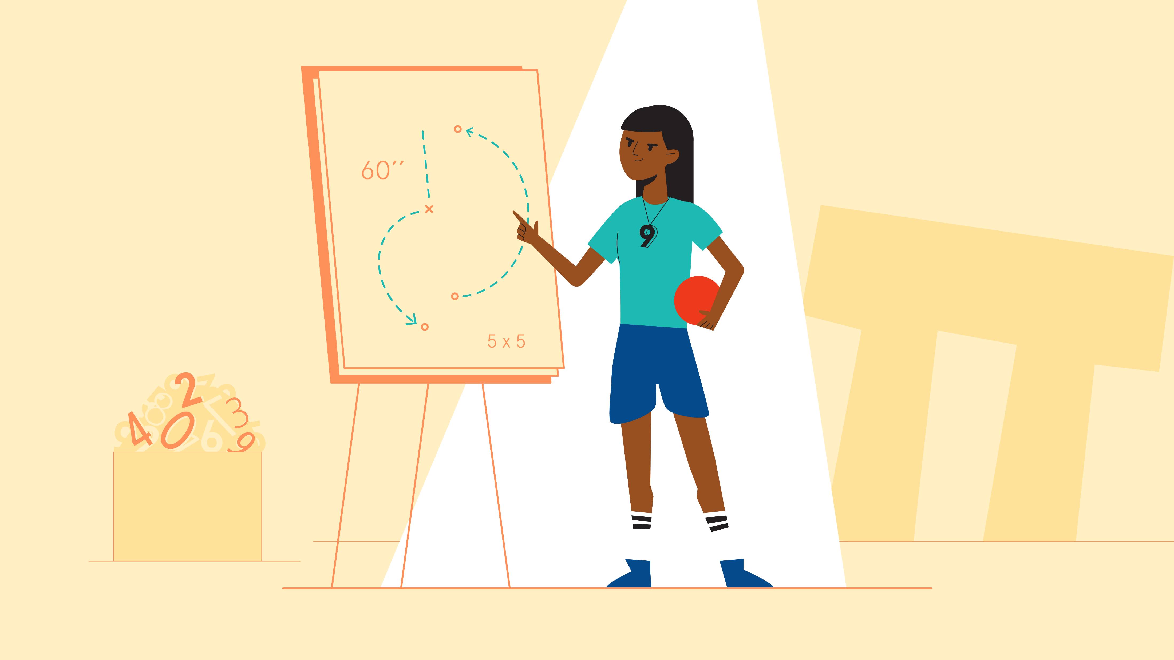
7. Teachers
Unjumble the answer:
isidvion
Notes:
USE A TIMER.
Teachers use division when dividing out resources, letters or materials to give out to groups of children in classes and year groups. Also when they work out test results.

Slide 13
Answers
Example: Weights
Statistics
Ratios
Algebra
Geometry
Measurements
Division
Notes:
OPTION: peer assess answers
Explanations for the teacher to use if suitable;
Doctors use statistics and probability to interpret tests results. When a patient is treated for an illness, the probability is used to determine which type of treatment to use, if any. Evidence-based medicine is the use of statistical models to guide diagnoses and treatment.
Ratios are used extensively in sports to measure the success rate of a particular task or skill. A sports professional uses math to calculate, understand and interpret these ratios. For example, footballer’s strike -rate percentage, which is the ratio of successful shots to total shots taken.
Police officers use algebra skills in traffic accident investigations. Algebra helps investigating officers calculate the speed of the vehicles involved, the distance travelled and the vehicles’ locations at the time of the collision. For police officers, detectives and crime scene investigators, algebra is a helpful tool in crime scene reconstruction. In cases involving death, investigators use algebra to estimate the time of death using factors such as climate conditions and body temperature. Algebra also is useful for ballistics in firearms-related offenses.
Geometry is integral to all forms of design. Fashion designers make use of it in decisions regarding shapes, patterns and prints, whereas angles play a role in determining necklines and hems, for instance. Architects use geometry to help them design buildings and structures. It can help architects express design images and to analyse as well as calculate possible structural problems.
Measurement is key for an artist to draw correct proportions and angles and a realistic interpretation of their subject. There are several measurement techniques that artists use including the use of grids, tick marks, rule of thumbs, rule of threes. A photographer uses measurement to determine light and exposure.
Teachers use division when dividing out resources, letters or materials to give out to groups of children in classes and year groups. Also when they work out test results.

Slide 14
Team challenge 1:
How many professionals you can think of that use maths?
Write down the job and example. (One point per job with example)
Notes:
OPTION 1 Suggested plenary and/or extension activity
Form groups and see which group/pair can think of the most jobs with an example type of maths used.
Set a time limit.
Ask each group/pair to feedback to the class to justify the points or swap answers and ask groups/pairs to mark each other’s work.
Option to run a scoreboard to see who gets 1st, 2nd, 3rd place etc.

Slide 15


Team challenge 2:
Think of a professional that uses each of the following types of maths. You’ll need to justify your answer. (One point per word tile)
Notes:
OPTION 2 PLENARY: Split the class into teams or pairs – for each word on the following slides, they need to come up with a job that uses the type of maths given. Extension: think of an example Up to 12 points available (1 for a job 1 for an example).
Set a time limit.
Ask each group to feedback to the class to justify the points or swap answers and ask groups to mark each other’s work.
Option to run a scoreboard to see who gets 1st, 2nd, 3rd place etc.

Slide 16
Word tiles
Notes:
If required, use for support in any of the 3 challenges, print and display around the room

Slide 17
Statistics
Notes:
For support, print and display around the room or as a presentation during challenge 2.

Slide 18
Ratios
Notes:
For support, print and display around the room or as a presentation during challenge 2

Slide 19
Algebra
Notes:
For support, print and display around the room or as a presentation during challenge 2

Slide 20
Geometry
Notes:
For support, print and display around the room or as a presentation during challenge 2

Slide 21
Measurement
Notes:
For support, print and display around the room or as a presentation during challenge 2

Slide 22
Division
Notes:
For support, print and display around the room or as a presentation during challenge 2

Slide 23
Multiplication
Notes:
For support, print and display around the room or as a presentation during challenge 2

